Slide 1
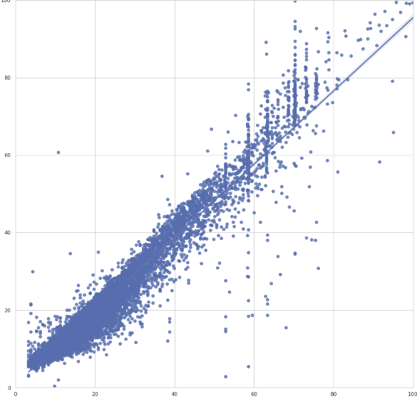
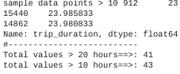
Regression Assumptions After Modeling
Executive summary report for the New York City Taxi and Limousine Commission Prepared by Automatidata
100
The New York City Taxi & Limousine Commission contracted Automatidata to predict customer taxi/rideshare durations to help understand its pricing and fleet viability.
80
60
Predicted
Linear regression model explains 95% price variance based on trip distance, tolls, tips, and payment.
265 pickup and destination codes significantly contributed to prediction performance.
40
20
0
0
20
40
60
80
100
Actual
Alt-text: Taxi pricing regression model plot illustrating predicted and actual cost.
Removing outliers optimized model (amount, passengers, distance).
Model provides a sound framework for predicting price based on pickup and destination distance IDs.
Regression assumptions
Net model tuning resulted in:
R^2 from 0.85 to 0.9
MAE from 0.16 to 0.14
RMSE from 0.39 to 0.23
Identification of a potentially curious influencer.
Tipping
Outlier removal had significant improvement on the model’s effectiveness.
Request additional data to perform 2nd stage reliability analysis for pricing & duration.
Consider fine tuning travel time greater than 10 hours (43 pts).

